Slide 1
ICT407: IT Governance in Organisations
Week 8:
Lecturer: Dr. Farshid Keivanian

Slide 2
Introduction to IT Governance, Risk, and Compliance (IT GRC)
Introductory Statement: IT Governance, Risk, and Compliance (IT GRC) is a framework that ensures that IT supports and enables the overall business strategy, while managing risks and complying with regulations.

Slide 3
Introduction to IT Governance, Risk, and Compliance (IT GRC)
Practical Scenario: Consider a large financial institution in Sydney that needs to ensure its IT systems are aligned with business objectives, mitigate cybersecurity risks, and comply with local regulations like the Australian Privacy Principles (APPs).
Class Discussion:
Question: Why is it important for an organization to have a strong IT GRC framework in place?
Response: IT GRC ensures that IT aligns with business goals, mitigates risks, and complies with regulations, which is crucial for maintaining trust and avoiding legal issues.

Slide 4
Introduction to IT Governance, Risk, and Compliance (IT GRC)
Multiple-Choice Question: Question: What is the primary goal of IT Governance? a) To increase IT expenses b) To minimize employee workload
c) To ensure IT aligns with business strategy d) To limit IT system usage

Slide 5
Key Principles of IT Governance
Introductory Statement: The key principles of IT governance include alignment, accountability, transparency, risk management, and performance measurement.

Slide 6
Key Principles of IT Governance
Practical Scenario: Imagine a tech startup in Melbourne that must establish clear roles and responsibilities for its IT team, ensuring accountability and transparency in decision-making processes.
Class Discussion:
Question: How can transparency in IT decision-making benefit an organization?
Response: Transparency ensures that stakeholders are informed, which builds trust and facilitates better decision-making.

Slide 7
Key Principles of IT Governance
Open-Ended Question:
Question: Can you think of an example where lack of accountability in IT governance led to a business failure?
Follow-Up Question:
Question: How could proper IT governance have prevented that failure?
Explanation: IT governance is about making sure IT decisions align with the business’s overall goals, ensuring clear accountability, transparency, and managing risks effectively.

Slide 8
Objectives of IT Governance, Risk, and Compliance (GRC)
Introductory Statement: The main objectives of GRC are to ensure that IT supports business goals, manages risks, and meets compliance requirements.

Slide 9
Objectives of IT Governance, Risk, and Compliance (GRC)
Practical Scenario: A retail company in Brisbane needs to ensure that its IT systems are secure and compliant with the Payment Card Industry Data Security Standard (PCI DSS) to protect customer data.
Class Discussion:
Question: What could be the consequences of failing to comply with IT regulations?
Response: Non-compliance can lead to legal penalties, loss of customer trust, and financial losses.

Slide 10
Objectives of IT Governance, Risk, and Compliance (GRC)
Open-Ended Question:
Question: How does GRC help in creating a risk-aware environment within a business?
Follow-Up Question: Question: What role does compliance play in reducing business risks?
Explanation: GRC helps businesses make informed decisions by creating a risk-aware environment, ensuring compliance with regulations, and aligning IT with business objectives.

Slide 11
Why is GRC Important?
Introductory Statement: GRC is crucial because it helps businesses navigate risks and comply with regulatory requirements in a rapidly changing environment.

Slide 12
Why is GRC Important?
Practical Scenario: A healthcare provider in Canberra must comply with the Australian Privacy Principles to ensure patient data is protected and secure.
Class Discussion:
Question: Why is it important for businesses to be risk-aware in today’s environment?
Response: Being risk-aware helps businesses anticipate and mitigate potential threats, ensuring long-term success and stability.

Slide 13
Why is GRC Important?
Open-Ended Question:
Question: Can you identify a situation where failing to manage IT risks led to significant consequences for a business?
Follow-Up Question:
Question: How could a better GRC framework have helped mitigate those risks?
Explanation: GRC is important because it helps businesses manage risks, comply with regulations, and make informed decisions in a complex business landscape.

Slide 14
What Drives GRC?
Introductory Statement: The key drivers of GRC include increased cyber risks, regulatory requirements, data privacy needs, and the complexity of modern business relationships.

Slide 15
What Drives GRC?
Practical Scenario: A logistics company in Sydney faces increasing risks due to the complex relationships with third-party vendors and needs to ensure its IT systems are secure and compliant.
Class Discussion:
Question: How do third-party relationships increase IT risks?
Response: Third-party relationships can introduce vulnerabilities, making it harder to control data security and compliance.

Slide 16
What Drives GRC?
Open-Ended Question: Question: What strategies can businesses use to manage the risks associated with third-party relationships?
Follow-Up Question: Question: How does compliance with data privacy laws help in mitigating these risks?
Explanation: GRC is driven by the need to manage cyber risks, comply with regulations, and ensure that businesses can operate securely in a complex and interconnected environment.

Slide 17
Group Class Activity – Presentation (Calibri Size 28 - f.keivanian@aapoly.edu.au)
Task: Design a basic IT governance framework for a fictitious company in Sydney. Each group should identify the key principles of governance, such as alignment, accountability, and transparency, and explain how these principles will be applied in the company’s IT strategy.
Discussion: Each group should present their framework, explaining their decisions and any challenges they faced. Consider how your governance framework would help the company manage risks and comply with regulations.

Slide 18
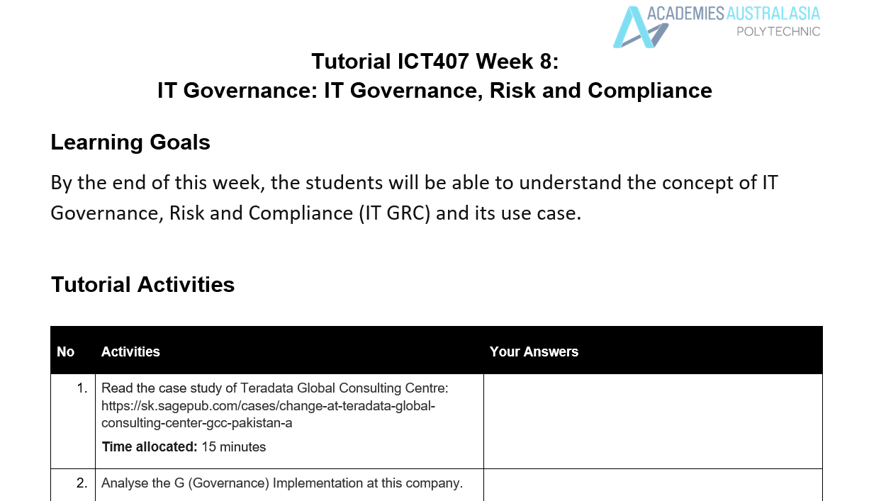
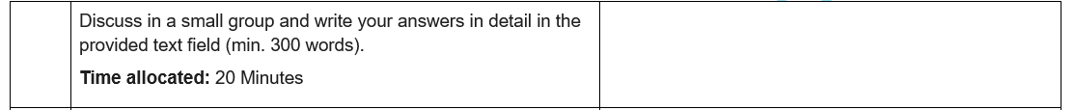
Tutorial Week 8

Slide 19
Tutorial Week 8
1. Governance (G) Implementation at Teradata Global Consulting Center (GCC) Pakistan
Teradata GCC Pakistan's governance implementation faced significant challenges, particularly during its attempt to achieve ISO 27001 certification. Governance in this context refers to how the organization structured its policies, roles, and responsibilities to ensure that information security management aligned with business goals and international standards.

Slide 20
Tutorial Week 8
Initially, the governance approach struggled due to resistance from line managers, who were supposed to enforce the new policies within their teams. The lack of buy-in from these managers indicated a governance gap where responsibilities were not clearly communicated or accepted. The resignation of the original ISMF Chairman further highlighted the governance issues, suggesting that there was a lack of alignment between the governance framework and the organization's culture.

Slide 21
Tutorial Week 8
When Kashif Jadoon took over as the new ISMF Chairman, he introduced a 'reverse strategy' to improve governance. This strategy involved getting a consensus across the organization about the importance of ISO 27001 certification. By making managers accountable and implementing a system where non-compliance would be reported regardless of designation, Kashif strengthened the governance structure. His approach also included motivating employees through competitions and educating them on the business value of certification. This revised governance model was more participative and aimed at building consensus, which ultimately helped in driving the implementation process more effectively.

Slide 22
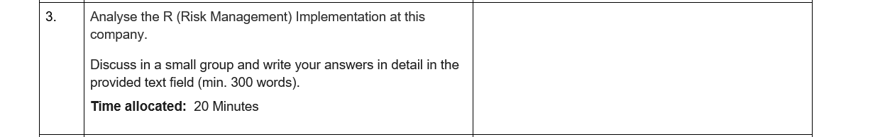
Tutorial Week 8
2. Risk Management (R) Implementation at Teradata Global Consulting Center (GCC) Pakistan
The risk management implementation at Teradata GCC Pakistan was closely tied to the ISO 27001 certification process, which is inherently focused on identifying and mitigating risks related to information security. Initially, the organization faced significant challenges in managing risks due to the resistance from line managers and their teams. This resistance itself posed a risk to the successful implementation of the certification, as it hindered the adoption of necessary security practices across the organization.

Slide 23
Tutorial Week 8
Under the leadership of Kashif Jadoon, the organization’s approach to risk management became more proactive. By conducting a second internal audit, Kashif’s team was able to identify gaps in the implementation and address them before the final external audit. This internal audit was a crucial risk management activity, as it allowed the team to reassess the organization's readiness and ensure that any outstanding issues were resolved.

Slide 24
Tutorial Week 8
Moreover, by holding managers accountable and enforcing a culture of compliance, Kashif mitigated the risk of non-compliance that could have jeopardized the certification process. The competitions and motivational strategies also served as risk management tools, as they increased employee engagement and reduced the likelihood of resistance. Overall, the revised approach to risk management under Kashif's leadership was more effective, focusing on internal audits, accountability, and employee motivation to ensure the organization was well-prepared for the external audit.

Slide 25
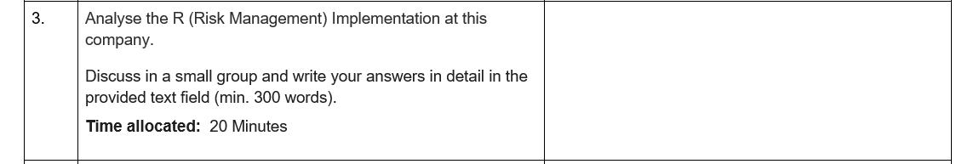
Tutorial Week 8
3. Compliance (C) Implementation at Teradata Global Consulting Center (GCC) Pakistan
Compliance at Teradata GCC Pakistan was centered around achieving ISO 27001 certification, a standard that ensures the organization’s information security management system (ISMS) meets international benchmarks. The initial attempt at compliance faced significant hurdles due to a lack of alignment between the compliance requirements and the organizational culture. Resistance from line managers and a lack of effective leadership contributed to the challenges in meeting compliance standards.

Slide 26
Tutorial Week 8
When Kashif Jadoon became the ISMF Chairman, he took a more structured approach to compliance. He understood that achieving compliance was not just about completing documentation but ensuring that the entire organization adhered to the processes required by the ISO 27001 standard. By making managers accountable and ensuring that compliance was monitored and reported regardless of designation, Kashif created a more rigorous compliance environment.

Slide 27
Tutorial Week 8
The second internal audit conducted by the ISO team under Kashif's leadership was a key component of the compliance strategy. This audit allowed the team to identify and rectify non-compliance issues before the final external audit. Additionally, by educating employees on the business value of compliance and using motivational strategies, Kashif was able to foster a culture of compliance throughout the organization. This approach not only addressed the immediate compliance needs but also set the foundation for ongoing adherence to the standards required by ISO 27001.

Slide 28
Preparation for Assessment 3
Overview: This assessment requires you to write a 1000-word report evaluating the risks involved in implementing a new billing system for a telecommunications company using the COBIT framework. Your report should also include recommendations to mitigate these risks.

Slide 29
Preparation for Assessment 3
Step 1: Understand the Task and Framework
COBIT Framework: Familiarize yourself with the COBIT framework, which is a comprehensive framework for managing and governing enterprise IT. Ensure you understand its principles, especially how it relates to risk management in IT implementations.
Telecommunications Context: Understand the specific challenges and risks associated with implementing IT systems in a telecommunications environment. This includes internal risks (such as system integration) and external risks (like regulatory compliance and customer data security).

Slide 30
Preparation for Assessment 3
Step 2: Research and Gather Information
Read Relevant Materials: Use the recommended readings and study materials provided in your course to deepen your understanding of IT risk management, the COBIT framework, and the specifics of the telecommunications industry.
Case Studies and Examples: Look for case studies or examples where COBIT has been applied in similar contexts. This will help you identify relevant risks and how they can be managed effectively.

Slide 31
Preparation for Assessment 3
Step 3: Structure Your Report Your report should include the following sections:
1. Executive Summary:
Briefly summarize the key findings and recommendations.
Highlight the most critical IT business risks identified.
2. Risk Identification:
Identify a wide range of relevant risks associated with the new billing system.
Consider both internal and external threats.

Slide 32
Preparation for Assessment 3
3. Risk Analysis:
Analyze each identified risk, assessing its likelihood and potential impact on the business.
Use appropriate risk scoring methodologies to justify your analysis.
4. Control Assessment:
Evaluate the effectiveness of existing controls in mitigating these risks.
Identify any gaps or weaknesses in the current control environment.

Slide 33
Preparation for Assessment 3
5. Recommendations:
Propose clear, actionable, and cost-effective recommendations to mitigate the identified risks.
Prioritize these recommendations based on the severity of the risks.

Slide 34
Preparation for Assessment 3
Step 4: Pay Attention to the Rubric
Executive Summary: Clearly summarize the key points. Ensure your summary is concise but comprehensive.
Risk Identification: Demonstrate a comprehensive understanding of IT business risks. Don’t miss out on identifying any critical risk.
Risk Analysis: Be thorough and accurate. Justify your likelihood and impact assessments with solid reasoning.
Control Assessment: Evaluate existing controls rigorously and identify any gaps.

Slide 35
Preparation for Assessment 3
Recommendations: Make sure your recommendations are actionable and prioritized.
Presentation & Formatting: Organize your report professionally, use clear formatting, and include visual aids like charts if necessary. Ensure the report is free from grammatical errors.
Citations & References: Properly cite all sources using a recognized style guide (e.g., APA). Ensure your references are current and relevant.

Slide 36
Preparation for Assessment 3
Step 5: Writing the Report
Clarity and Conciseness: Write clearly and concisely. Avoid jargon unless necessary and always explain technical terms.
Logical Flow: Ensure your report flows logically from one section to the next. Each section should build on the previous one.
Use Examples: Where applicable, use examples to illustrate your points, especially in the Risk Identification and Risk Analysis sections.

Slide 37
Preparation for Assessment 3
Step 6: Review and Revise
Proofread: Carefully proofread your report for any grammatical errors, typos, or inconsistencies.
Cross-Check Against Rubric: Before submitting, cross-check your report against the assessment rubric to ensure you have met all the criteria for a high distinction.

Slide 38
Preparation for Assessment 3
Step 7: Seek Feedback
Use Studiosity: Take advantage of online study support like Studiosity to get feedback on your assignment’s structure, language, and references.
Ask Questions: If you’re unsure about any part of the assignment, reach out to your lecturer or use the forums to ask questions.
Step 8: Submit on Time
Early Submission: Aim to complete your report a few days before the deadline to avoid any last-minute issues.
Turnitin: Submit your assignment through Turnitin as required

Slide 39
Preparation for Assessment 3
Practical Example (Similar but Different from Assessment):
Scenario: A financial institution is implementing a new customer relationship management (CRM) system. Identify and evaluate the risks associated with the data migration process from the old system to the new one. Propose recommendations using the COBIT framework to mitigate these risks.
By following this guide, you will be well-prepared to excel in your Assessment 3 and aim for a high distinction mark. Good luck!

Slide 40
Preparation for Assessment 3
Review of Rubric Criteria
1. Executive Summary:
Excellent: Summarizes the report’s key findings and recommendations effectively, highlighting the most critical IT risks with a clear focus on the COBIT framework and telecommunications context.
Good: Provides a general overview but lacks specific details or fails to fully align with the COBIT framework.
Satisfactory: Lacks depth or omits key information, with minimal reference to the COBIT framework.
Needs Improvement: Lacks relevance or fails to mention the COBIT framework and industry context altogethe

Slide 41
Preparation for Assessment 3
2. Risk Identification:
Excellent: Identifies a broad range of risks, both internal and external, and justifies them using the COBIT framework.
Good: Identifies most major risks but may miss some key areas or not fully justify them using the COBIT framework.
Satisfactory: Limited in scope, with weak justification and minimal use of the COBIT framework.
Needs Improvement: Risks are poorly identified or missing, with no reference to the COBIT framework.

Slide 42
Preparation for Assessment 3
3. Risk Analysis:
Excellent: Thoroughly analyzes each risk using appropriate scoring methodologies, clearly linked to the COBIT framework.
Good: Analyzes risks but lacks depth or consistency in applying the COBIT framework.
Satisfactory: Superficial analysis with limited or inconsistent reference to the COBIT framework.
Needs Improvement: Analysis is poorly developed, with no meaningful application of the COBIT framework.

Slide 43
Preparation for Assessment 3
4. Control Assessment:
Excellent: Effectively evaluates current controls, identifies gaps, and connects them to COBIT principles.
Good: Identifies controls but may miss some gaps or fail to fully connect to COBIT.
Satisfactory: Limited assessment, with weak or no connection to COBIT principles.
Needs Improvement: Control assessment is inadequate, with no reference to COBIT.

Slide 44
Preparation for Assessment 3
5. Recommendation:
Excellent: Proposes actionable and well-prioritized recommendations based on COBIT and industry best practices.
Good: Provides recommendations but lacks detail, prioritization, or connection to COBIT.
Satisfactory: Recommendations are vague or generic, with little connection to the COBIT framework.
Needs Improvement: Recommendations are irrelevant or poorly connected to the COBIT framework.

Slide 45
Preparation for Assessment 3
6. Presentation & Formatting:
Excellent: Professionally formatted with clear headings, charts, and no errors, making the report easy to read.
Good: Generally well-organized but may have minor formatting issues or errors.
Satisfactory: Cluttered presentation with noticeable errors, making the report difficult to follow.
Needs Improvement: Poorly formatted and difficult to navigate, with significant errors.

Slide 46
Preparation for Assessment 3
7. Citations & References:
Excellent: Accurate and well-formatted citations, with relevant and up-to-date references on COBIT and the telecommunications industry.
Good: Mostly accurate citations, with some minor issues. References are relevant but could be broader or more current.
Satisfactory: Inconsistent citation formatting, with outdated or irrelevant references.
Needs Improvement: Citations are missing or poorly developed, with little relevance to the COBIT framework or industry.

Slide 47
Preparation for Assessment 3
This refined rubric ensures that you are not only evaluated on general report writing skills but also on your ability to apply the COBIT framework within the specific context of the telecommunications industry, which is crucial for achieving a high distinction.

